Slide 1
DIABETES PREDICTION USING MACHINE Learning
Guided by:
G . Indira priyadarshni
(associate professor)
PROJECT team members:
B . Pravalika – 20911A1213
P . Rajasree - 20911A1241
T . Bhavana – 20911A1251

Slide 2
ABSTRACT
Diabetes is a disease caused due to the increase level of blood glucose. Various traditional methods based on physical and chemical tests are available for diagnosing diabetes. Our task is to make predictions on medical data. This system proposes a diabetes prediction model utilizing machine learning techniques with data from the Pima dataset. The machine learning model is trained using the Support Vector Machine (SVM) algorithm. Input features such as BMI, glucose levels, number of pregnancies, and blood pressure are utilized to build an accurate prediction model. The trained model is then evaluated using input data to assess whether an individual is likely to have diabetes or not. This research aims to enhance early diagnosis and management of diabetes through the implementation of advanced machine learning techniques

Slide 3
INTRODUCTION:
According to International Diabetes Federation 382 million people are living with diabetes across the whole world.
The data which is collected is trained using various algorithms. Healthcare professionals working in this area have their own limits and cannot forecast the probability of high accuracy in diabetes.
The project aims to improve diabetes prediction using SVM algorithm of machine learning considering the healthcare dataset from the open source of PIMA dataset sets which classifies the patients whether they are having diabetes or not.

Slide 4
Existing system:
Many Existing systems handled for diabetes detection . Data mining approach like clustering, classification were studied in existing system .Diabetes prediction using algorithms such as KNN,k-means was proposed. A basic diabetic dataset is chosen for carrying out the comparative analysis . The importance of feature analysis for predicting diabetes by employing machine learning technique is discussed . In this system the accuracy of detection is less.

Slide 5
Drawbacks of existing system:
Implemented only conventional Machine Learning Algorithms and couldn't promise high accuracy and performance.
This area of research still faces limitations related to lack of data preprocessing steps and issues related to validation...
The performance of ML models does not necessarily show any improvement

Slide 6
Proposed system:
The proposed system is classification of Indian PIMA dataset for diabetes as binary classification problem. This is proposed to achieve through machine learning algorithm. For machine learning, SVM algorithm is proposed .The proposed system improves accuracy of prediction through Machine learning techniques.
ADVANTAGES:
Accuracy is improved using machine learning.
Individual user predictions are implemented.

Slide 7
System requirements:
Hardware Requirements:
Processor :Any processor above 500 MHz.
Ram :4GB
Hard Disk :4GB
Input Device :Standard keyboard and Mouse
Software Requirements:
Operating System :Windows 7 or higher
Programming :Python 3.6 and related libraries

Slide 8
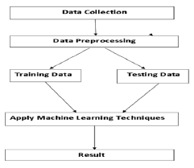
System architecture:

Slide 9
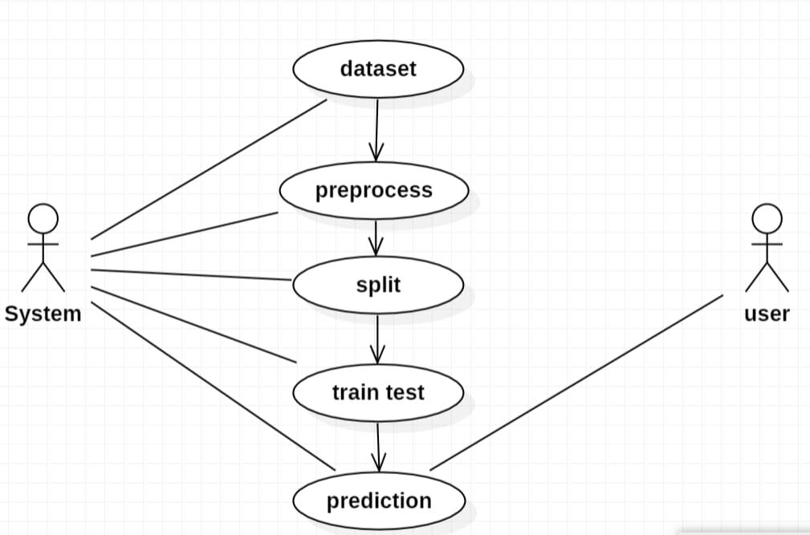
Usecase diagram:

Slide 10
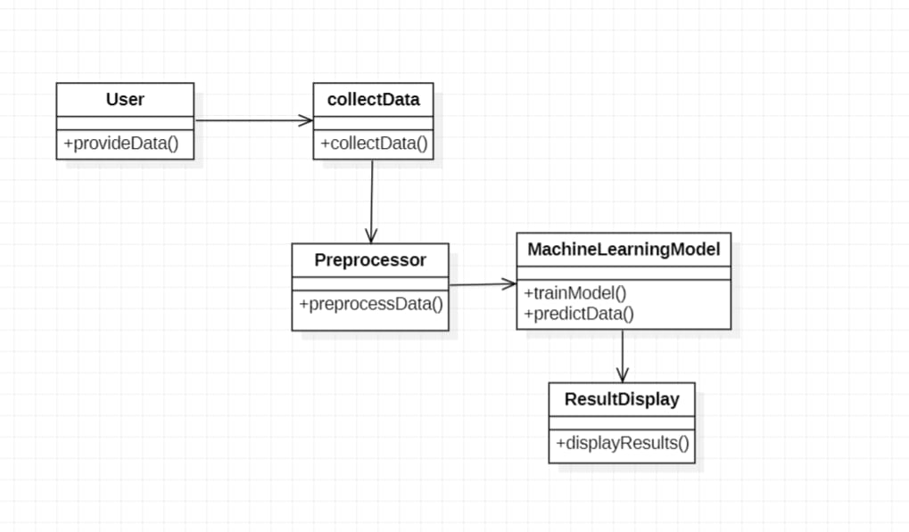
class diagram:

Slide 11
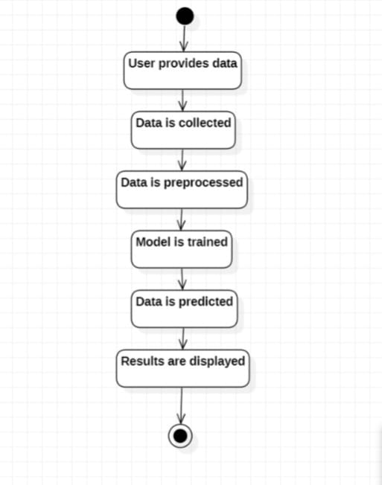
ACTIVITY DIAGRAM:

Slide 12
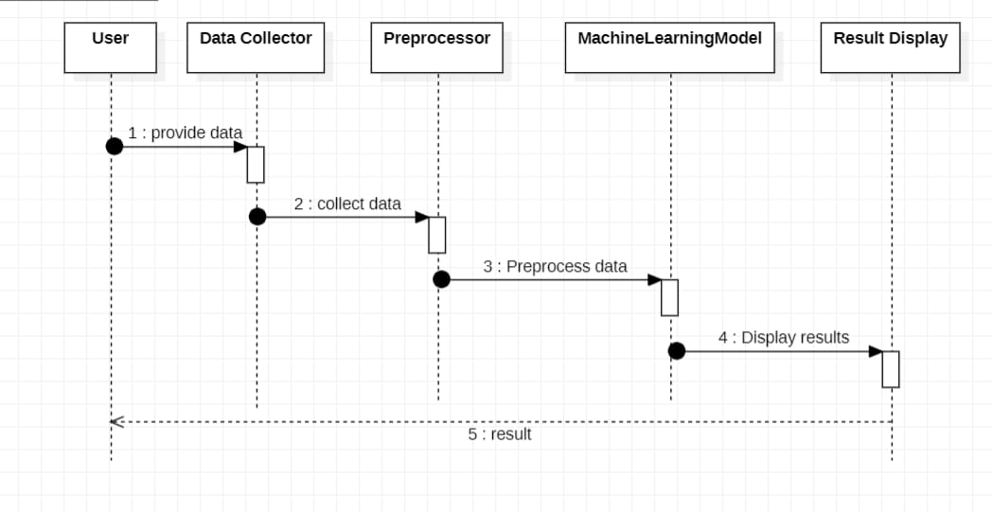
Sequence DIAGRAM:

Slide 13
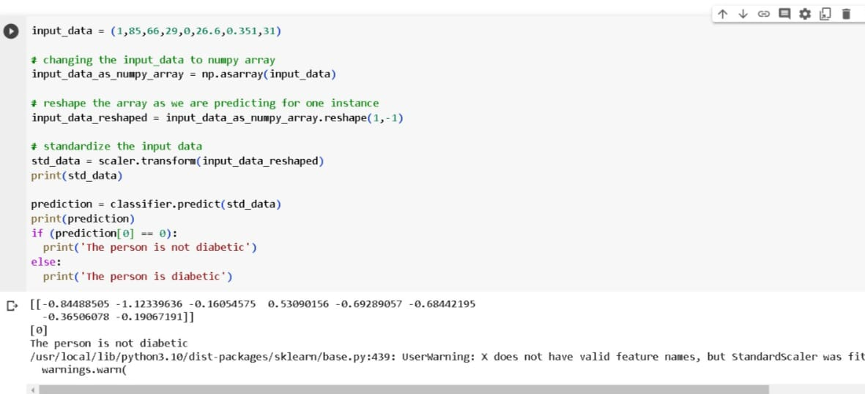
output screens:

Slide 14
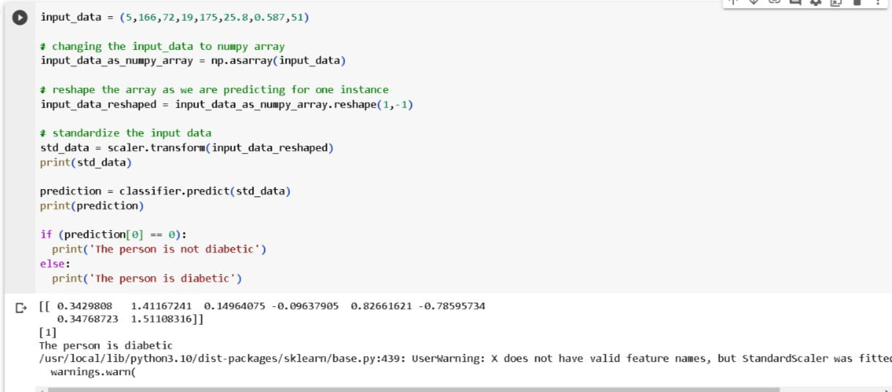

Slide 15
Conclusion:
The main objective of project is to classify and predict diabetes using machine learning algorithms is being discussed throughout the project.
We build the model using machine learning algorithm that is support vector machine, it is supervised learning algorithm in machine learning.

Slide 16
Future enhancement:
There is no interactive tool for users to predict diabetes.
Due to small size of dataset, an accuracy of 77% for the model is achived. This issue can be resolved by continuously gathering more data in training model.

Slide 17
Thank you

